Slide 1
ARP Protocol
Address resolution protocol

Slide 2
What is ARP
Address Resolution Protocol
Translates IP addresses to physical addresses (like MAC addresses)
It can be forward (ARP) or reverse (RARP)
In IPv6 this functionality is provided by the Neighbor Discovery Protocol (NDP)

Slide 3
RARP (Reverse Address Resolution protocol)
Obsolete computer networking protocol used by a client computer to request its Internet Protocol (IPv4) address from a computer network, when all it has available is its link layer or hardware address, such as a MAC address. The client broadcasts the request, and does not need prior knowledge of the network topology or the identities of servers capable of fulfilling its request
We currently use DHCP (dynamic host configuration protocol) to obtain IP addresses

Slide 4
ARP Operating Scope
Request and response protocol whose messages are encapsulated by a link layer protocol
It is communicated within the boundaries of a single network, never routed across internetwork nodes

Slide 5
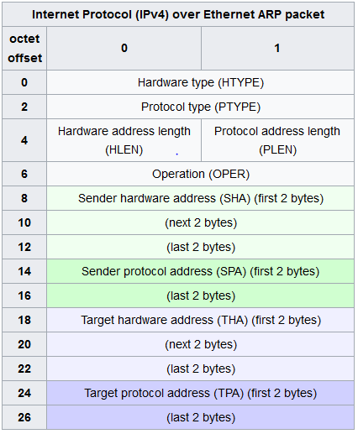
Packet structure

Slide 6
Packet structure
Hardware type (HTYPE) –specifies the network protocol type. Example: Ethernet is 1
Protocol type (PTYPE) - specifies the internetwork protocol for which the ARP request is intended. For IPv4, this has the value 0x0800
Hardware length (HLEN) - Length (in octets) of a hardware address. Ethernet addresses size is 6
Protocol length (PLEN) - Length (in octets) of addresses used in the upper layer protocol. (The upper layer protocol specified in PTYPE.) IPv4 address size is 4.
Operation - 1 for request, 2 for reply

Slide 7
Packet structure
Sender hardware address (SHA) – in an ARP request this field is used to indicate the address of the host sending the request. In an ARP reply this field is used to indicate the address of the host that the request was looking for
Sender protocol address (SPA) – Internetwork address of the sender
Target hardware address (THA) - Media address of the intended receiver. In an ARP request this field is ignored. In an ARP reply this field is used to indicate the address of the host that originated the ARP request
Target protocol address (TPA) - Internetwork address of the intended receiver.

Slide 8
ARP announcements
ARP may also be used as a simple announcement protocol
It is an ARP request containing the sender's protocol address (SPA) in the target field (TPA=SPA), with the target hardware address (THA) set to zero. An alternative way is to broadcast an ARP reply with the sender's hardware and protocol addresses (SHA and SPA) duplicated in the target fields (TPA=SPA, THA=SHA)
An ARP announcement is not intended to solicit a reply; instead it updates any cached entries in the ARP tables of other hosts that receive the packet. The operation code may indicate a request or a reply because the ARP standard specifies that the opcode is only processed after the ARP table has been updated from the address fields

Slide 9
Proxy ARP
Because ARP does not provide methods for authenticating ARP replies on a network, ARP replies can come from systems other than the one with the required Layer 2 address. An ARP proxy is a system which answers the ARP request on behalf of another system for which it will forward traffic, normally as a part of the network's design, such as for a dialup internet service

Slide 10
ARP spoofing (poisoning)
In ARP spoofing the answering system, or spoofer, replies to a request for another system's address with the aim of intercepting data bound for that system. A malicious user may use ARP spoofing to perform a man-in-the-middle or denial-of-service attack on other users on the network. Various software exists to both detect and perform ARP spoofing attacks, though ARP itself does not provide any methods of protection from such attacks
This works because ARP does not have a way to validate if responses are valid, and also PCs cache all responses they get from the network, even if they were not requested, as to speed up connections

Slide 11
Questions?

